Slide 1

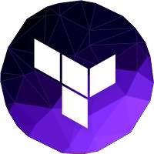
Infrastructure as Code with
Terraform
11/2023

Slide 2
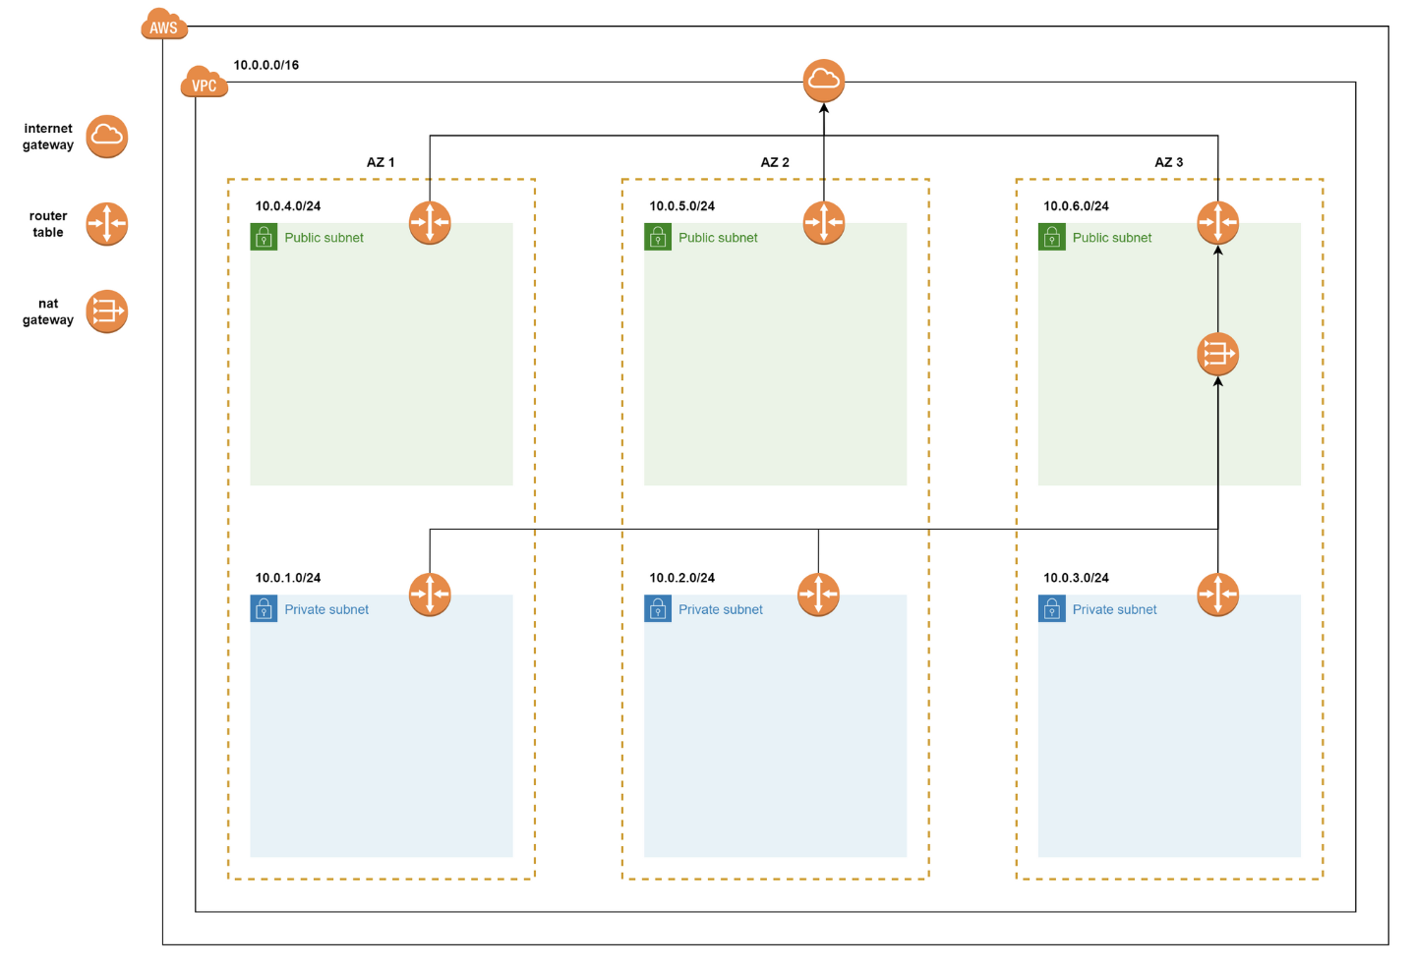
What we have done last meeting
Create
Create an AWS VPC with Terraform
Introduce
Introduce Terraform Module and Create VPC Module
Publish
Publish the VPC Module

Slide 3
What we will have in the 4th part:
Host a static website with S3 – 1st meeting (DONE)
Create AWS Virtual Private Cloud with Terraform – 2nd meeting (DONE)
Deploying a Multi-Tier Web Application – 3rd

Slide 4
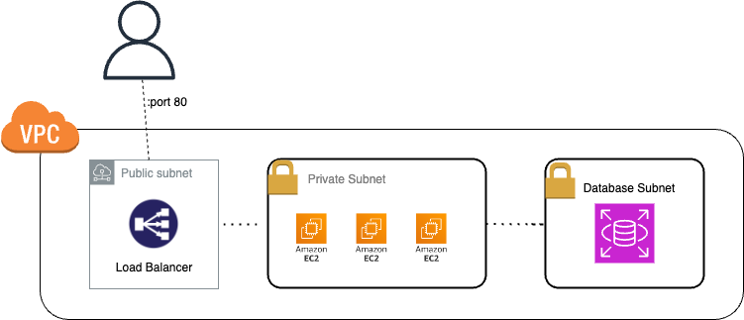
Part 3
Build infrastructure for a real application with Terraform Module
Notes:
From an architectural point of view, we’re going to put some EC2 instances in an autoscaling group and then put that behind a load balancer. The load balancer will be public-facing, meaning it can be accessed by anyone. In contrast, both the instances and database will be on private subnets with firewall rules dictated by security groups.

Slide 5
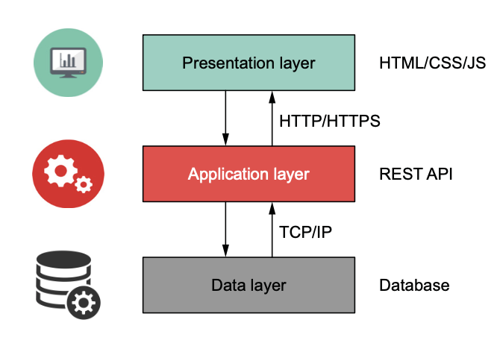
"Multi-tiered" simply refers to a software system that is organized into logical layers,
much like the layers of a cake. A three-tiered design is popular
because it creates a clear separation between the frontend and backend.
Notes:
Before we start, let's understand what a multi-tiered application means.
Imagine it like this: the frontend is what users interact with and is known as the UI or presentation layer. It's what you see on a website - buttons, images, and how things are arranged. On the other hand, the backend is where the magic happens behind the scenes, and users don't directly see it.
The backend is divided into two parts. First, there's the application layer, often implemented as a REST API. This part handles specific tasks and processes information. Second, there's the persistent storage or data access layer, which is like the memory of the system. It's where we store and retrieve data, much like a database.
The top layer is what users interact with, the middle layer handles tasks, and the bottom layer stores and manages data.

Slide 6
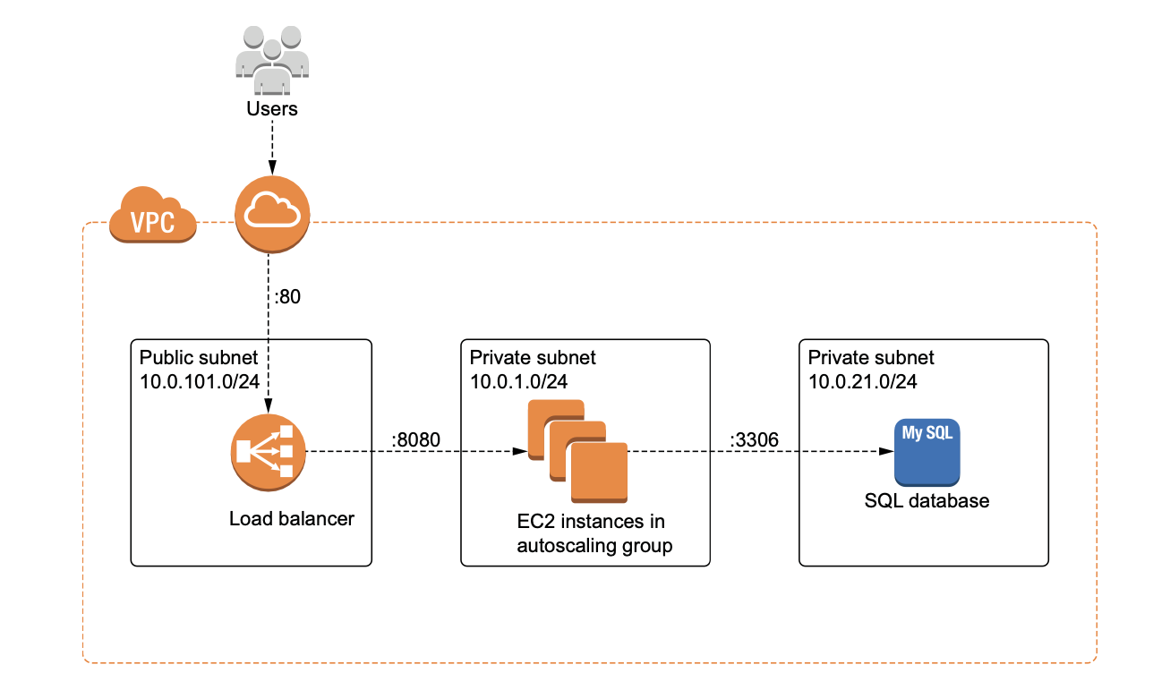
Architecture diagram for the multi-tiered web application
Notes:
From an architectural point of view, we’re going to put some EC2 instances in an autoscaling group and then put that behind a load balancer. The load balancer will be public-facing, meaning it can be accessed by anyone. In contrast, both the instances and database will be on private subnets with firewall rules dictated by security groups.

Slide 7
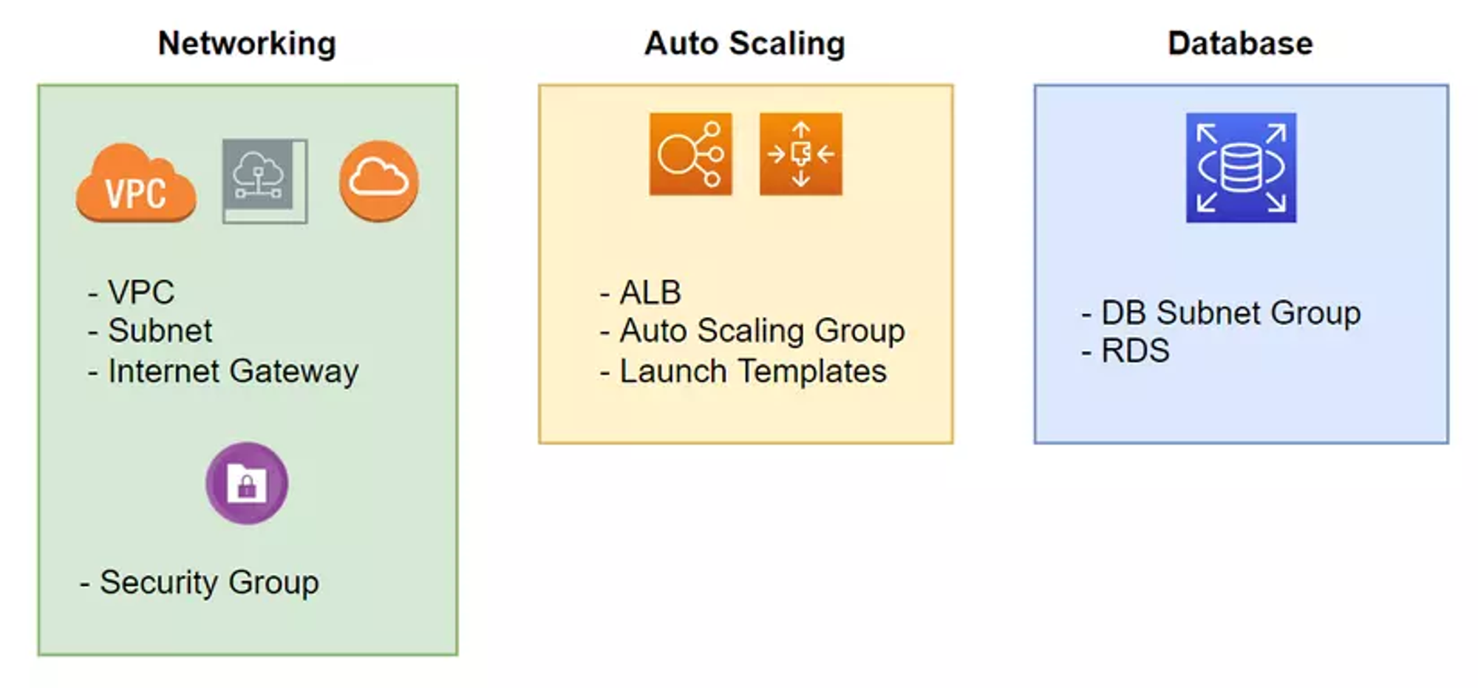
For this scenario, we will split the project into three major components:
Notes:
○ Networking—All networking-related infrastructure, including the VPC, subnets, and security groups
○ Database—The SQL database infrastructure ○ Autoscaling—Load balancer, EC2 autoscaling group, and launch template
resources
Amazon RDS (Relational Database Service) is a fully managed relational database service provided by Amazon Web Services (AWS). It is designed to make it easier to set up, operate, and scale a relational database in the cloud. With Amazon RDS, you can offload database administration tasks, such as hardware provisioning, database setup, patching, and backups, to AWS, allowing you to focus more on your application and less on database management.
A launch template in Terraform is used to define and configure settings for launching Amazon EC2 instances or instances in an Auto Scaling group on AWS.

Slide 8
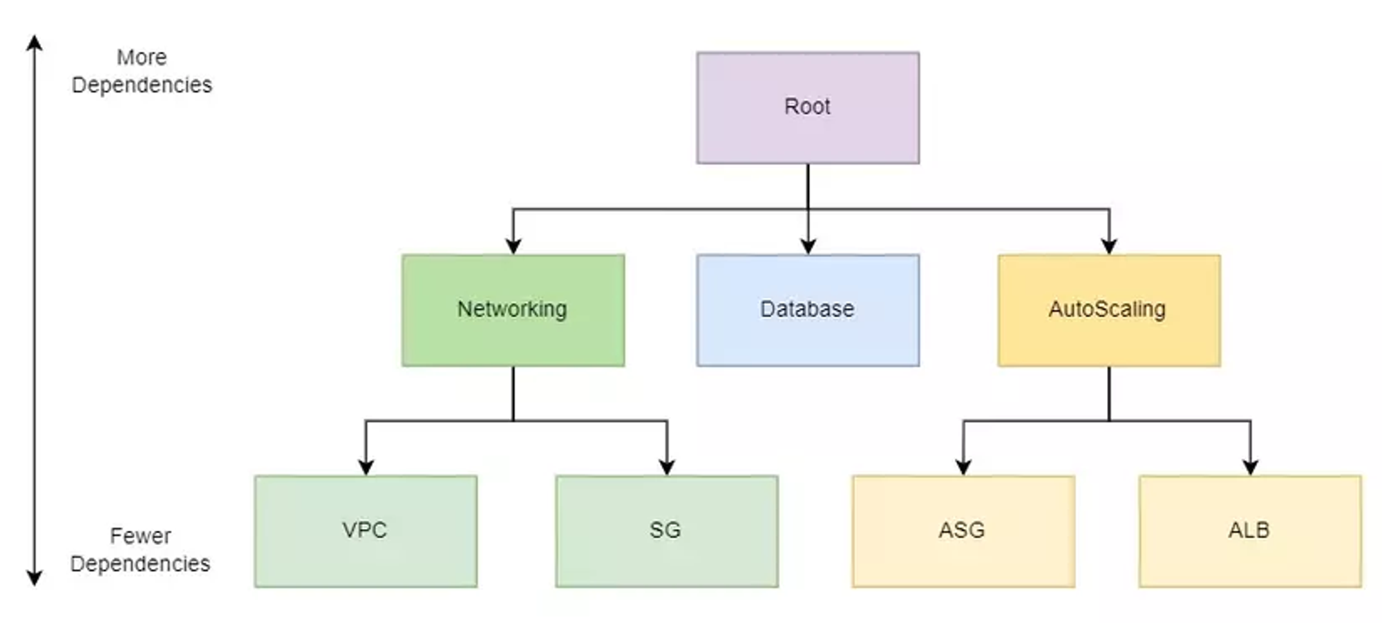
We will write Modules for Networking, AutoScaling and Database.
All Modules are related to each other in a tree model, with the guy at the top being called the Root Module.
Notes:
Modules are self-contained packages of code that allow you to create reusable components by grouping related resources together. You don’t have to know how a module works to be able to use it; you just have to know how to set inputs and outputs. Modules are useful tools for promoting software abstraction and code reuse.
Every workspace has a root module ; it’s the directory where you run terraform apply. Under the root module, you may have one or more child modules to help us organize and reuse configuration. The module can be a Local Module with code located on our computer or a Remote Module( a Module that is placed on the network and we download using the terraform init command).
As we can see in the pictured above, we will have three components: networking, database, and autoscaling. They are child module.
And each component contains one or more other child, like Networking it contains VPC module and SG (Security Group) module. If a Module is in another Module, we call it Nested Module.

Slide 9
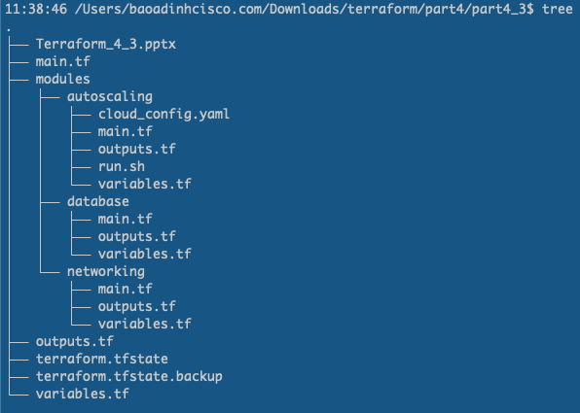
Same as last time, when we delpoyed VPC module, we will write the code follow the
standard module structure as below:

Slide 10
Define Root Module
Notes:
The root module is the top-level module. It’s where user-supplied input variables are configured and where Terraform commands such as terraform init and terraform apply are run.

Slide 11
In our root module, there will be one input variable and two output values.
A user of the root module only needs to set the project_name variable to deploy the project.
Root Module
db_password
project_name
lb_dns_name
The output values we’ll receive contain the provisioned load balancer’s DNS name (lb_dns_name)
and the database password (db_password).
The load balancer DNS name is important because it’s how the user will navigate to the website
from a web browser
Notes:
The root module is the top-level module. It’s where user-supplied input variables are configured and where Terraform commands such as terraform init and terraform apply are run.

Slide 12
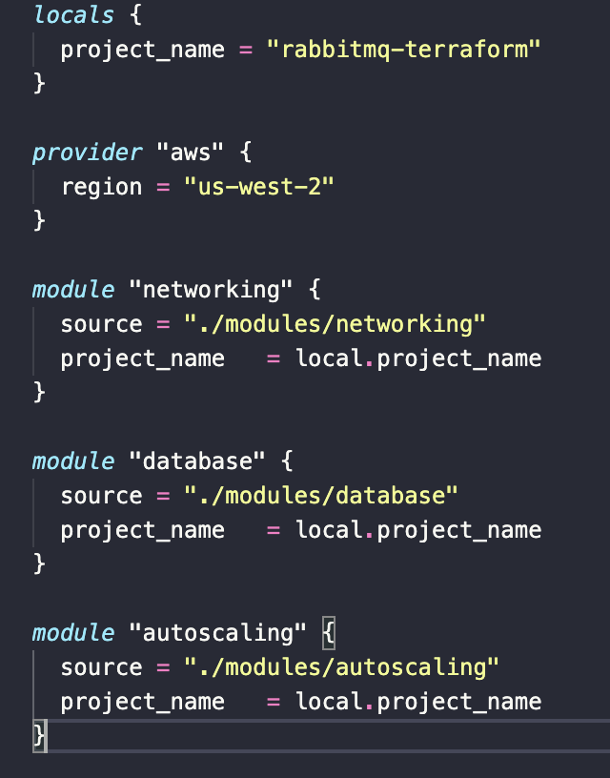
In the main.tf file of Root Module
The project_name variable is a project indetifier.
Each child uses local.project_name for resource
naming.
Nested child modules are sourced from a local modules
directory.

Slide 13
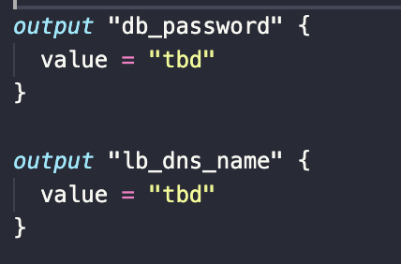
In the outputs.tf file of Root Module
Add two output here as discussed in the previous slide. We will update the value later.

Slide 14
Networking Module

Slide 15
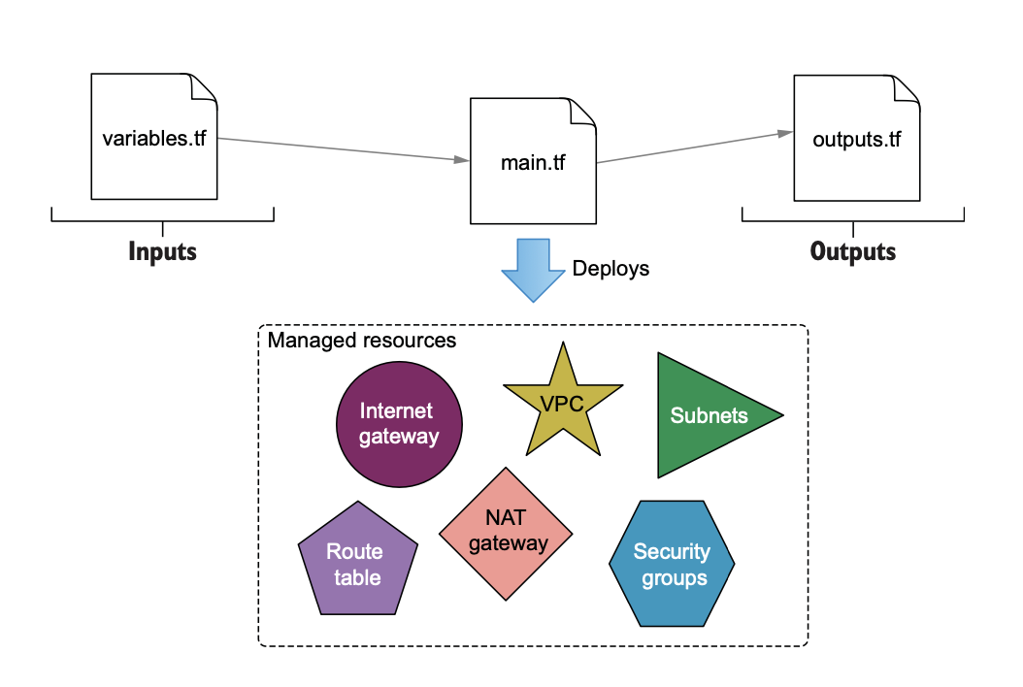
Overall inputs and outputs of the networking module
Networking module
vpc
project_name
sg
Notes:
The networking module is the first of three child modules we’ll look at. This module is responsible for provisioning all networking-related components of the web app, including Virtual Private Cloud (VPC), subnets, the internet gateway, and security groups. Overall inputs and outputs are shown in figure

Slide 16
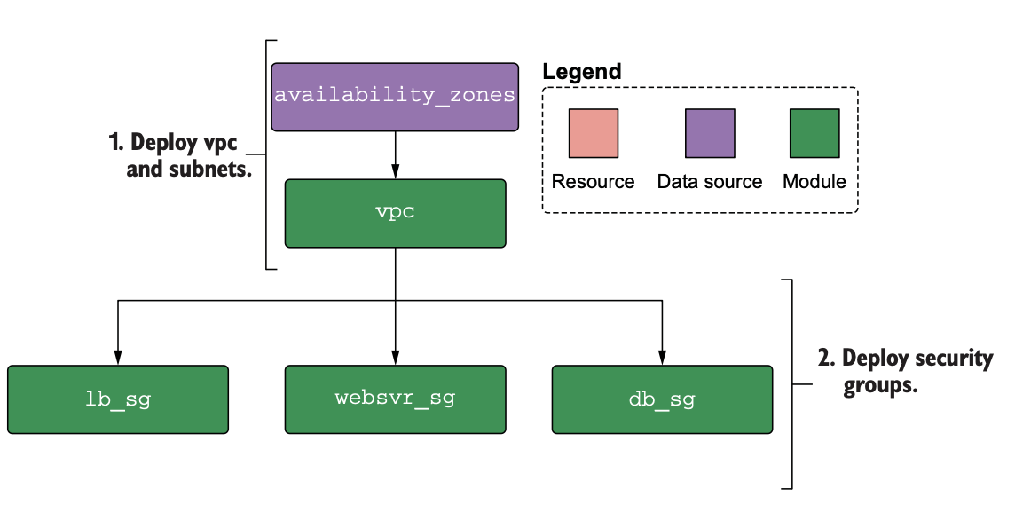
Notes:
We will deploy the vpc network same as last time we did. But this time, I will use the Remote Module that published in the internet, because it has more options and more configuration for us to deploy the multi-tier web app

Slide 17
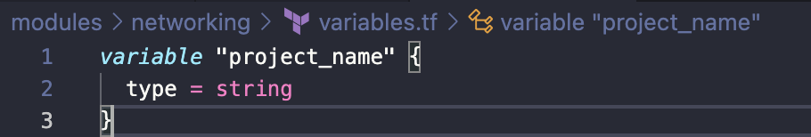
Create a new directory with the path ./modules/networking. In this directory,
create three files: variables.tf, main.tf, and outputs.tf. We’ll start with variables.tf

Slide 18
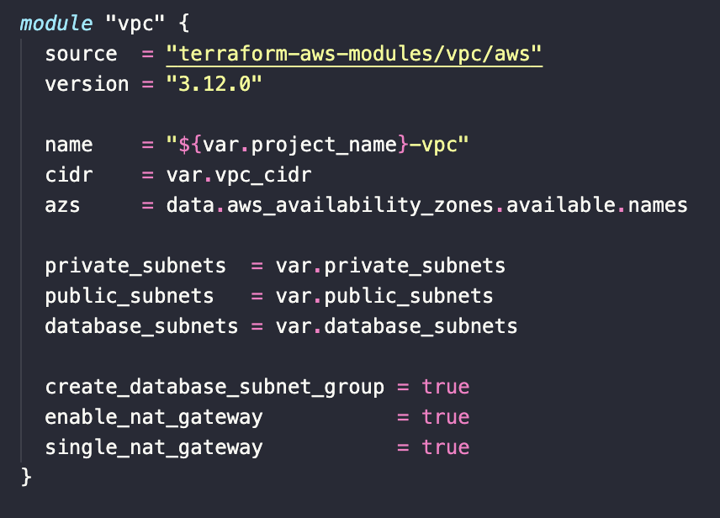
We will use Remote Module to install VPC network in the main.tf of Networking Module
AWS VPC module published
in the Terraform Registry
https://registry.terraform.io/modules/terraform-aws-modules/vpc/aws/latest
Notes:
This is the Remote Module that we will use the terraform init command to download. This module will create a VPC for us. With the above values, our VPC when created will look like as the next slide
Why we need the security group?
security groups provide a robust mechanism for controlling network traffic in AWS, ensuring that only necessary and authorized communication occurs between different components of the infrastructure.

Slide 19
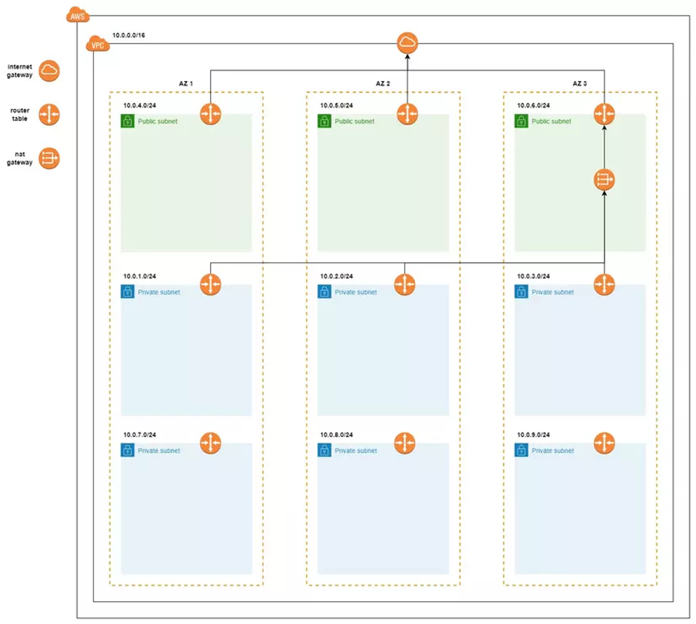
Notes:
This is our VPC network regarding to the configuration we have made in the previous slide

Slide 20
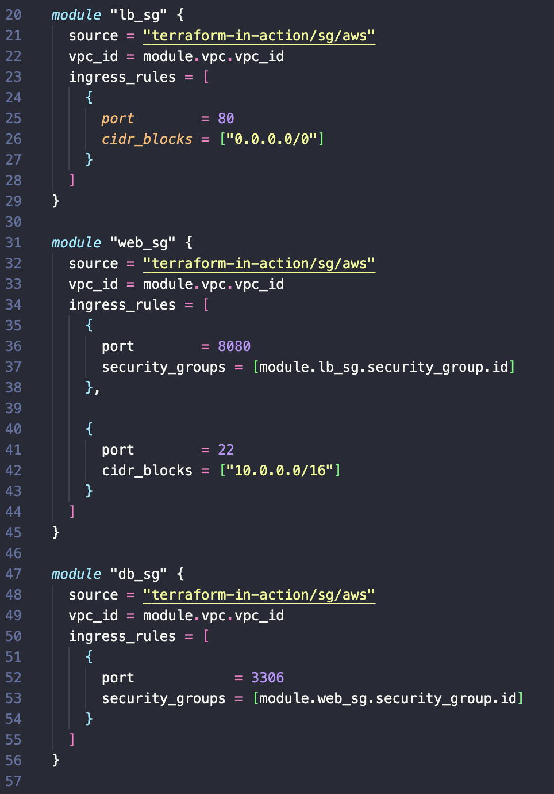
Next step, we will proceed to create a Secutiry Group for our VPC. Our Security Group must allow the following 3 things:
Allows access to port 80 of LB from anywhere
Allow access to port 8080 of EC2s from LB
Allow access to port 3306 of RDS from EC2
Notes:
This module is creating a security group for a load balancer.
It's using the terraform-in-action/sg/aws module as the source to create the security group.
The vpc_id parameter specifies the VPC (Virtual Private Cloud) ID where this security group will be created.
The ingress_rules parameter defines an ingress rule allowing traffic on port 80 from any source (0.0.0.0/0)
This module is creating a security group for a web server.
It's also using the terraform-in-action/sg/aws module.
The vpc_id parameter specifies the VPC ID.
The ingress_rules parameter allows traffic on port 8080, but this time the source is restricted to the security group associated with the load balancer (module.lb_sg.security_group.id).
This module is creating a security group for a database server.
Similar to the others, it's using the terraform-in-action/sg/aws module.
The vpc_id parameter specifies the VPC ID.
The ingress_rules parameter allows traffic on port 3306, but this time the source is restricted to the security group associated with the web server (module.web_sg.security_group.id). In summary, these modules are establishing a security group hierarchy where web_sg allows traffic from lb_sg on port 80, and db_sg allows traffic from web_sg on port 5432

Slide 21
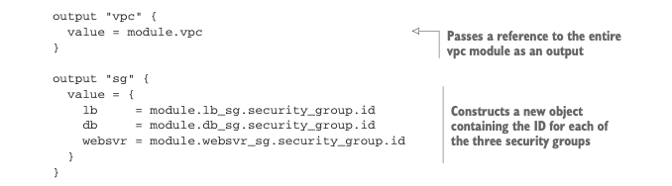
In order to make the external Modules to be able to access the values ​​of this Module,
we need to define an output value for it. Create outputs.tf file.

Slide 22
Database Module

Slide 23
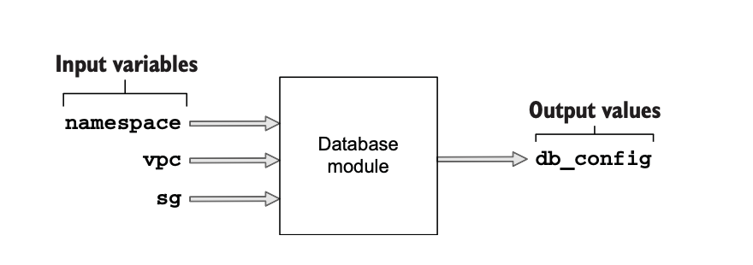
Notes:
The database module does exactly what you would expect: it provisions a database. The inputs and outputs are shown in figure

Slide 24
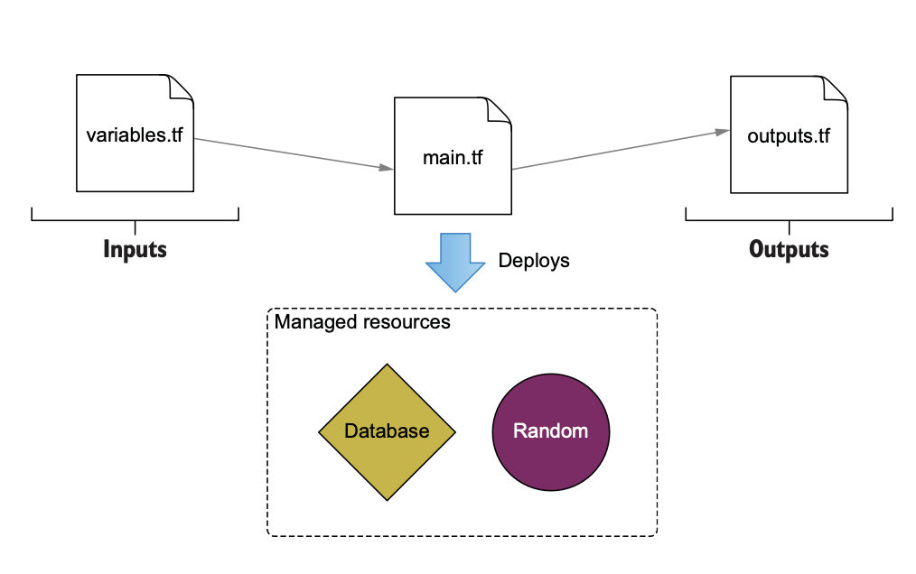
Notes:
We didn’t write this one first because the database module has an implicit dependency on the networking module, and it requires references to the VPC and database security groups.

Slide 25
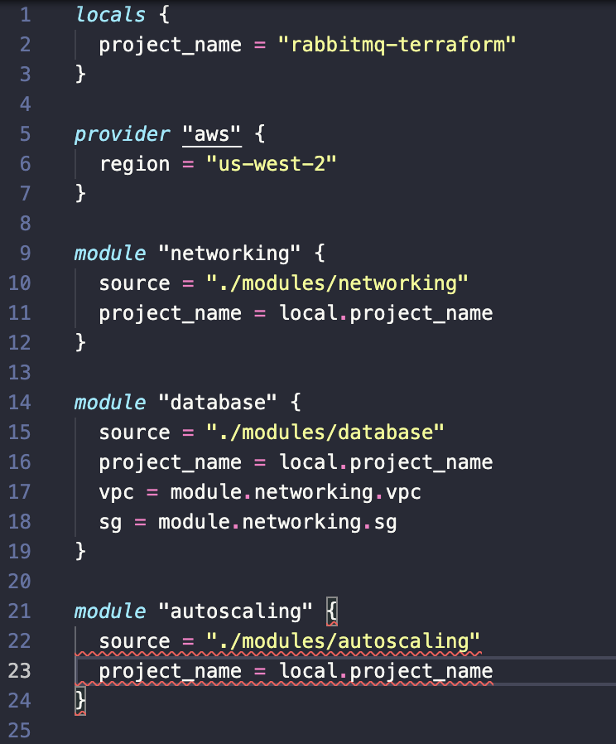
We didn’t write this one first because the database module has an implicit dependency
on the networking module, and it requires references to the VPC and database security groups.
Now, update the main.tf of root module to declare the input variables for database:

Slide 26
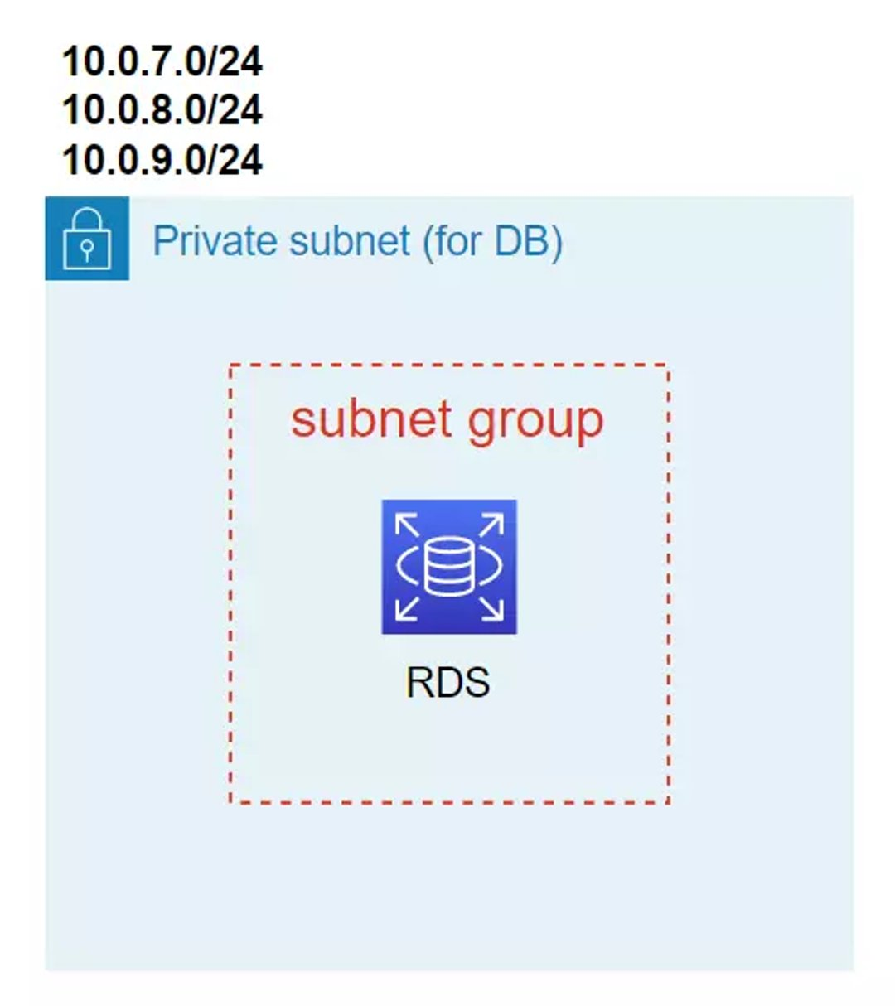
Notes:
On AWS, when we create RDS, we need to have a Subnet Group first, then RDS can be deployed on that Subnet Group.

Slide 27
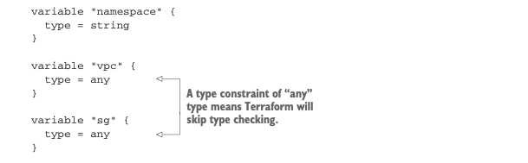
Create a ./modules/database directory, and create three files in it:
variables.tf, main.tf, and outputs.tf.
The variables.tf file contains the input variables for namespace, vpc, and sg
Notes:
Next, we have to create the database module. Create a ./modules/database directory, and create three files in it: variables.tf, main.tf, and outputs.tf. The variables.tf file contains the input variables for namespace, vpc, and sg .
In this code, we specify the type of vpc and sg as any. This means we allow any kind of data structure to be passed in, which is convenient for times when you don’t care about strict typing.

Slide 28
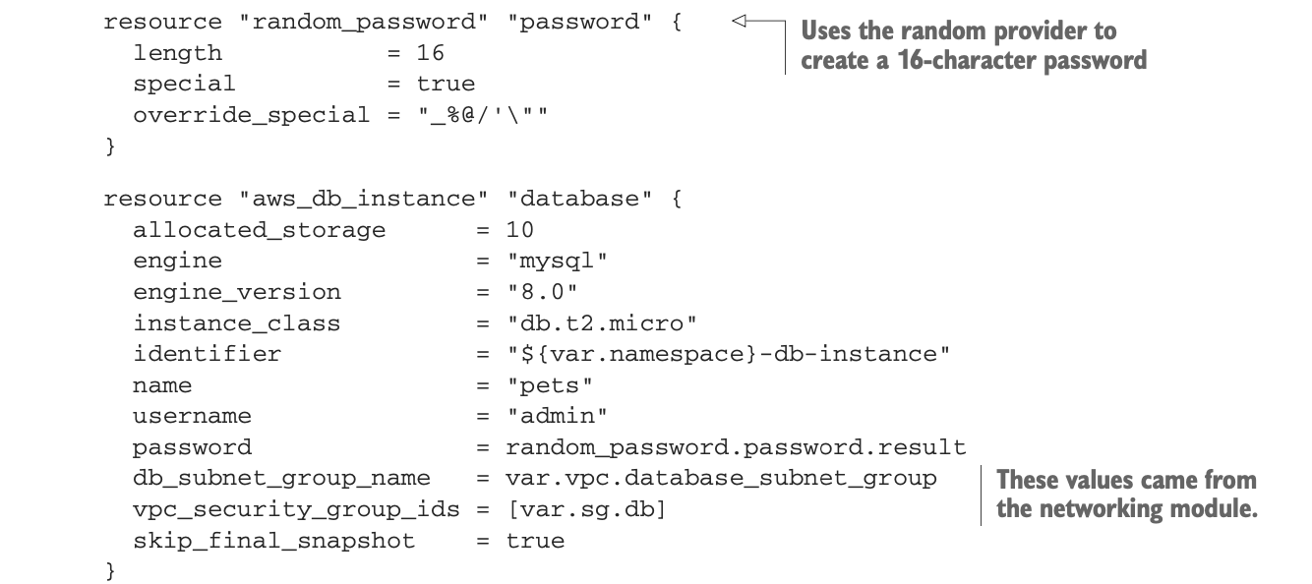
Notes:
To create RDS (Relational Database Service) on AWS, we will use the aws_db_instance resource. Above, we specify the RDS Engine we will use as MySQL version 8.0, with 10GB of storage, the Subnet Group value of RDS we take the value passed from the VPC variable. Everything seems fine, but you notice that in the password field, we are currently setting the value as hard. What if we don't want to set the value as hard but we want this value to be dynamic? we will generate a random password for the database with the help of our old friend, the Random provider.
Note that when we use this resource, our Password will be stored in the State file. At this time, anyone who accesses the State file can see the Password, leading to our security not being good, we will Discuss the issue of security in another article

Slide 29
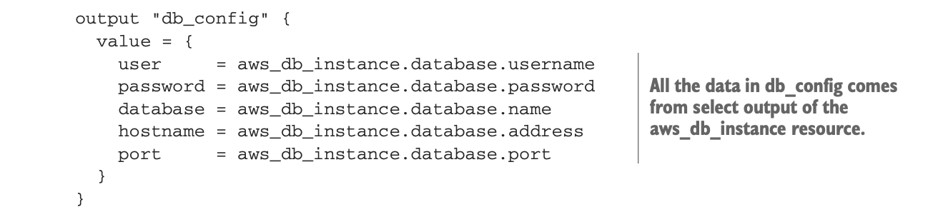
We export the RDS value so that we can be easy to access it later. In the outputs.tf

Slide 30
Okidoki, we have finished writing the Database Module,
let's update the main.tf file at Root to be able to use the Module.

Slide 31
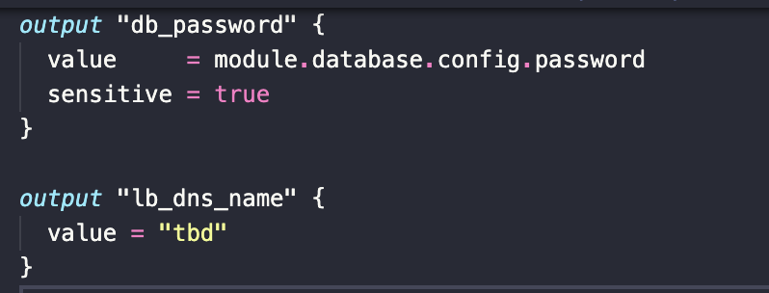
Changing back to the root module, let’s add some plumbing:
we can make the database password available to the CLI user by adding an output value in outputs.tf. Doing
so makes the database password appear in the terminal when terraform apply is run.

Slide 32
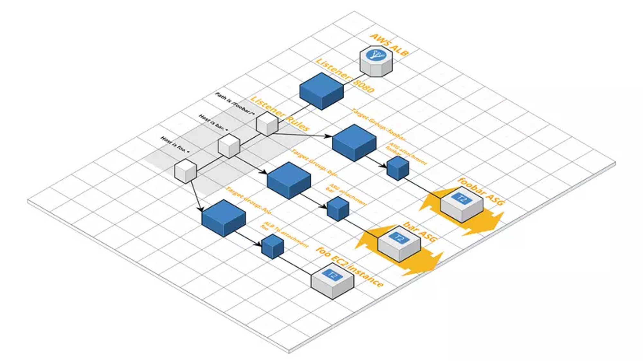
Autoscaling Module

Slide 33
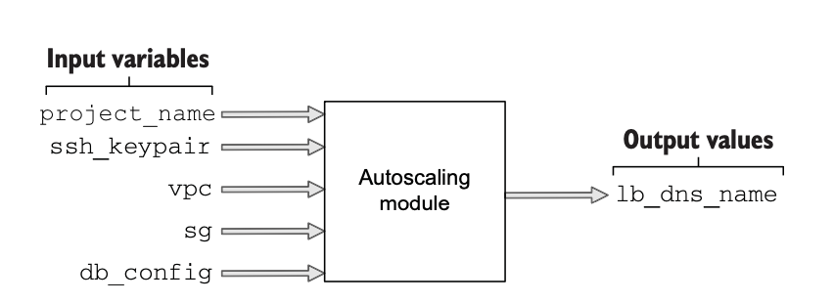
This module provisions the autoscaling group, load balancer, Identity and Access Management (IAM)
instance role, and everything else the web server needs to run.
Notes:
This module provisions the autoscaling group, load balancer, Identity and Access Management (IAM) instance role, and everything else the web server needs to run. The inputs and outputs for the module are shown in the figure

Slide 34
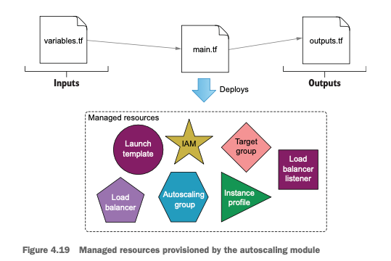
Notes:
With the Inputs in the previous slide, we will deploy these resources

Slide 35
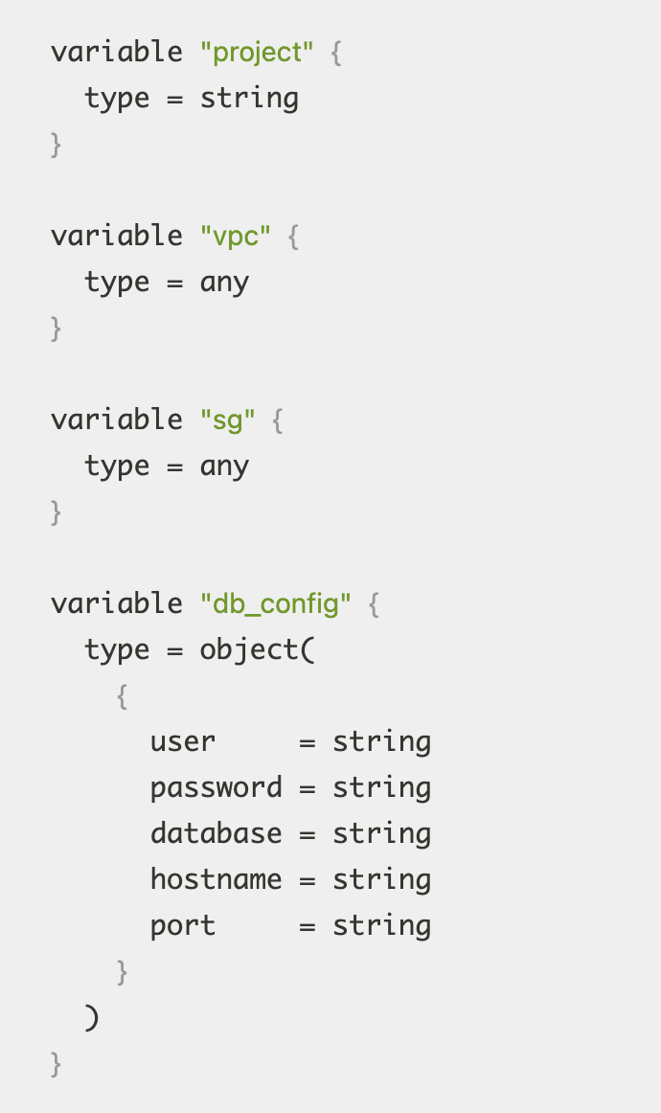
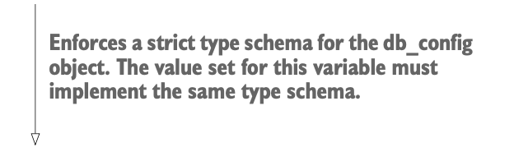
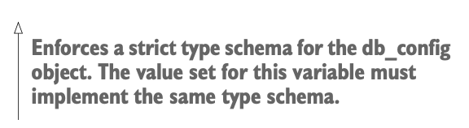
As before, the module’s input variables are declared
in variables.tf. Create a ./modules/autoscaling directory,
and in it create variables.tf.

Slide 36
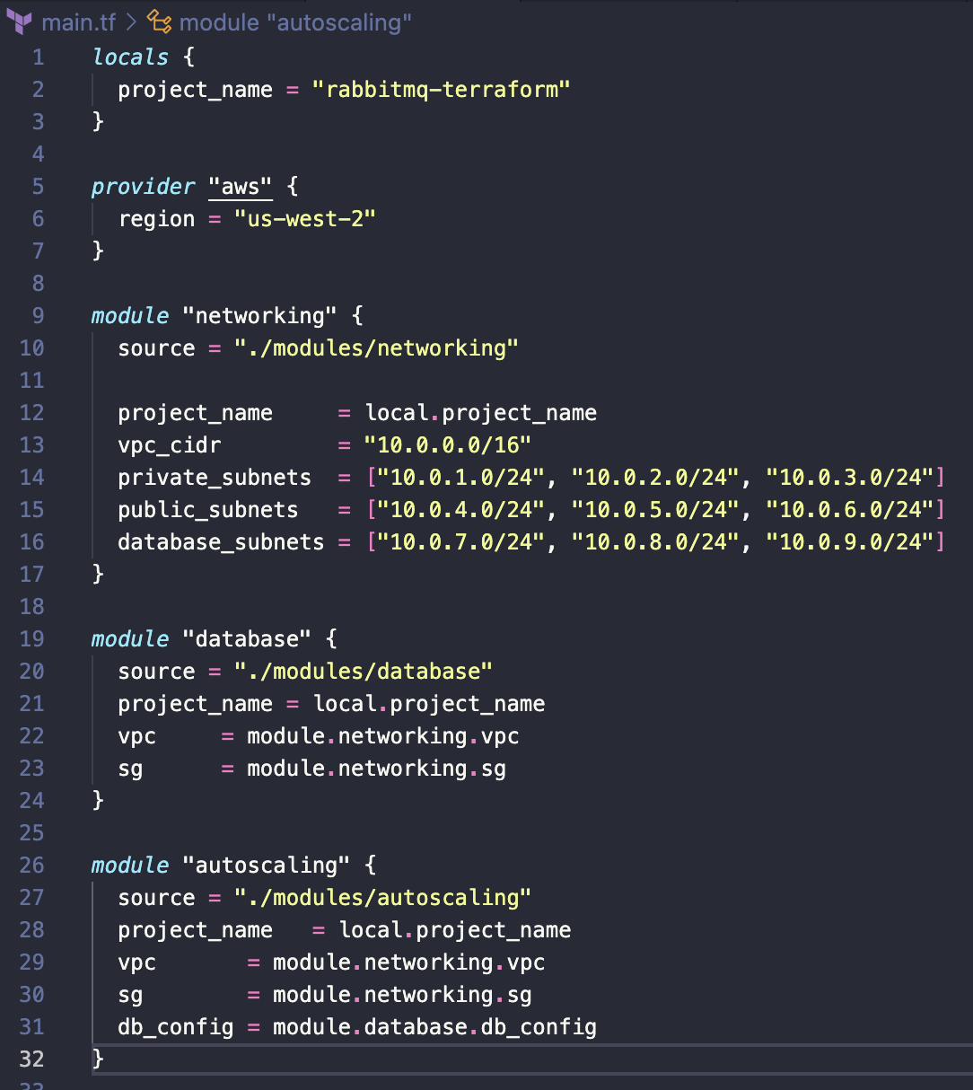


The first thing we need to do is update main.tf in the root module to trickle data down into the autoscaling module.

Slide 37
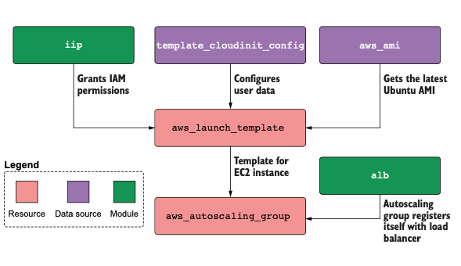
We are going to use a cloudinit_config data source to create the user data for our launch template.
Notes:
cloud-init is a package commonly used in cloud computing environments to perform initialization tasks on virtual machines when they are deployed. It is widely adopted by cloud service providers,
such as AWS, Azure, Google Cloud, and others.
cloudinit_config typically refers to the configuration file used by cloud-init to customize
the behavior of the initialization process.
This Terraform configuration creates a scalable web server infrastructure with an Auto Scaling Group, Launch Template, IAM Instance Profile, and an Application Load Balancer. It uses cloud-init for customization and deploys resources with AWS EC2 instances running Ubuntu.
As you can see in the figure Slide 34. We need the below resources to configure the aws_lauch_template:
An iip module to grant permissions to EC2 instances (IAM permissions)
The cloud-init configuration ensures that EC2 instances are configured with specific settings.
An aws_ami to retrieve the most recent Ubuntu Amazon Machine Image (AMI)
The launch template specifies the configuration details for launching EC2 instances.
The ALB (Application Load Balancer) provides load balancing for incoming traffic and directs it to the instances in the Auto Scaling Group.
The Auto Scaling Group: Creates an Auto Scaling Group (ASG) for EC2 instances, specifying configurations like the group name, size, subnets, target groups, and launch template.

Slide 38
Let’s make the main.tf for autoscaling module

Slide 39
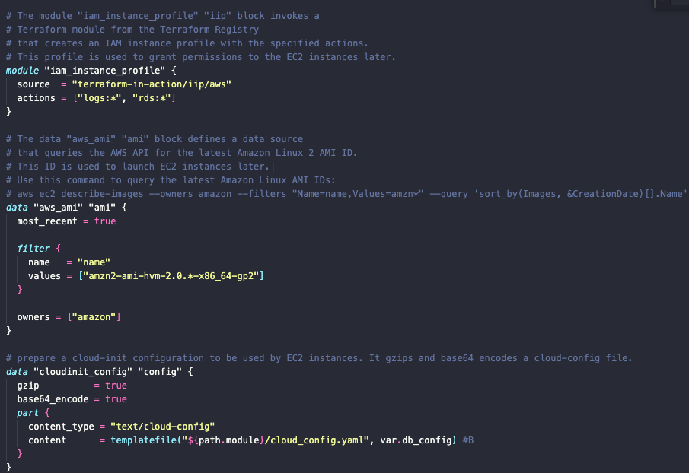

Slide 40
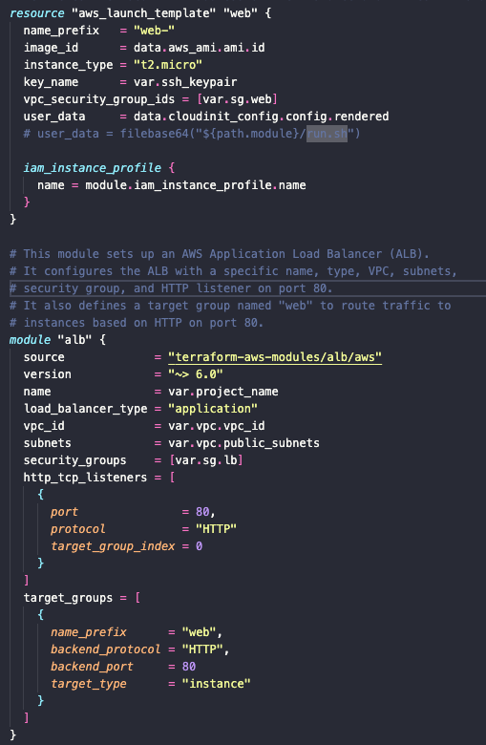
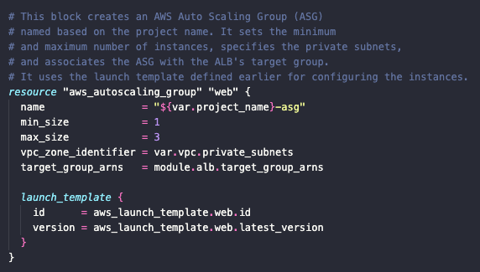
Content for the cloud init configuration comes from a
template file.

Slide 41
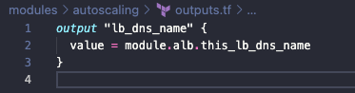
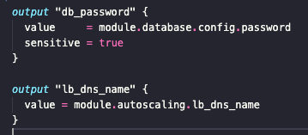
Finally, the output of the module is lb_dns_name.
This output is bubbled up to the root module and simply makes it easier to find the DNS name after deploying.
We also have to update the root module to include a reference to this output.

Slide 42

Deploying the web application

Slide 43
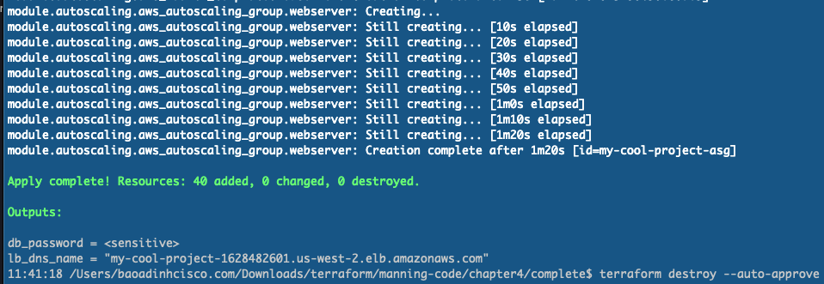
At this point, we’re ready to deploy the web application into AWS.
Change into the root module directory, and run terraform init followed by
terraform apply - auto-approve. After waiting ~10–15 minutes
(it takes a while for VPC and EC2 resources to be created), the tail of your output will be something like this:

Slide 44
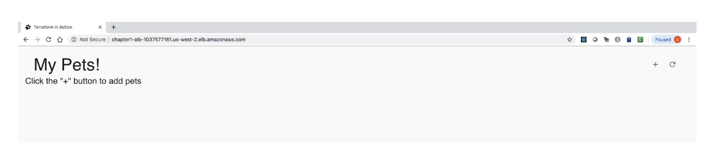
copy the value of lb_dns_name into your web browser of choice to navigate to the website.

Slide 45

Clean up

Slide 46
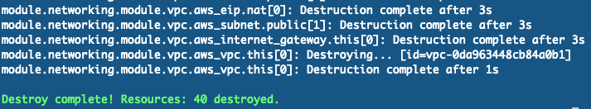
Because AWS resources usually cost money, we might want to remove them after we’re done
with testing. To do that, use the terraform destroy command and confirm with "yes"
Notes:
As we can see, using Terraform to create VPC is quite simple. But every time we want to create another VPC, do we have to copy this code somewhere else? The answer is no! To solve the problem of coding, Terraform provides us with a feature called Module, which helps us organize code into Modules and can be reused many times.

Slide 47

Summary
Complex projects, such as multi-tiered web applications in AWS, are easy to design and deploy with the help of Terraform modules.
The root module is the main entry point for your project.
Nested modules organize code into child modules. Child modules can be nested within other child modules without limit. Generally, you don’t want your module hierarchy to be more than three or four levels deep, because it makes it harder to understand.
Many people have published modules in the public Terraform Registry. You can save a lot of time by using these open-source modules instead of writing comparable code yourself; all it takes is learning how to use the module interface
Notes:
In this chapter, we designed and deployed a Terraform configuration for a multi- tiered web application in AWS. We broke out individual components into separate modules, which resulted in several layers of nested modules. Nested modules are a good design for complex Terraform projects, as they promote software abstraction and code reuse, although passing data can become tedious. In the next chapter, we investigate an alternative to nested modules: flat modules. A generalized way to struc- ture nested module hierarchies is shown in figure 4.24.

Slide 48

THE END

Slide 49
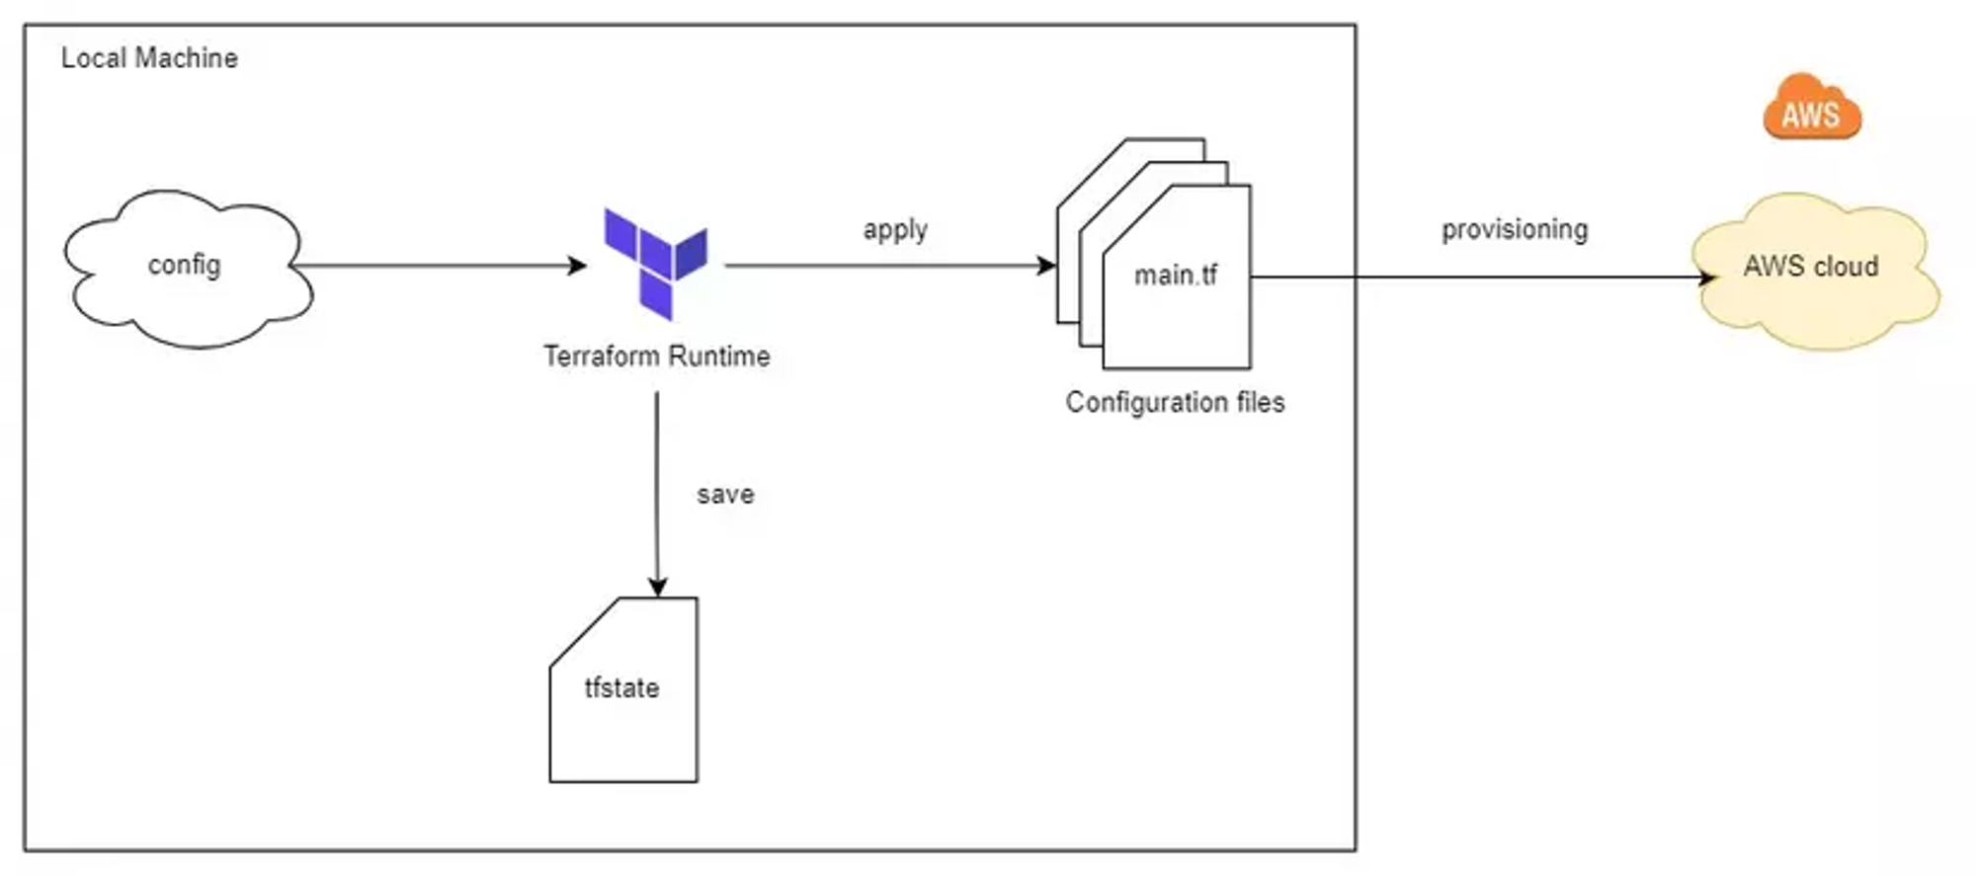
Upcoming topic: Terraform backend

Slide 50

Q&A
Notes:
https://someguys.blog/posts/2017-04-26-recovering-terraform-state/
https://medium.com/version-1/recovering-from-a-deleted-terraform-state-file-5e030c88aae0

